Slide 1
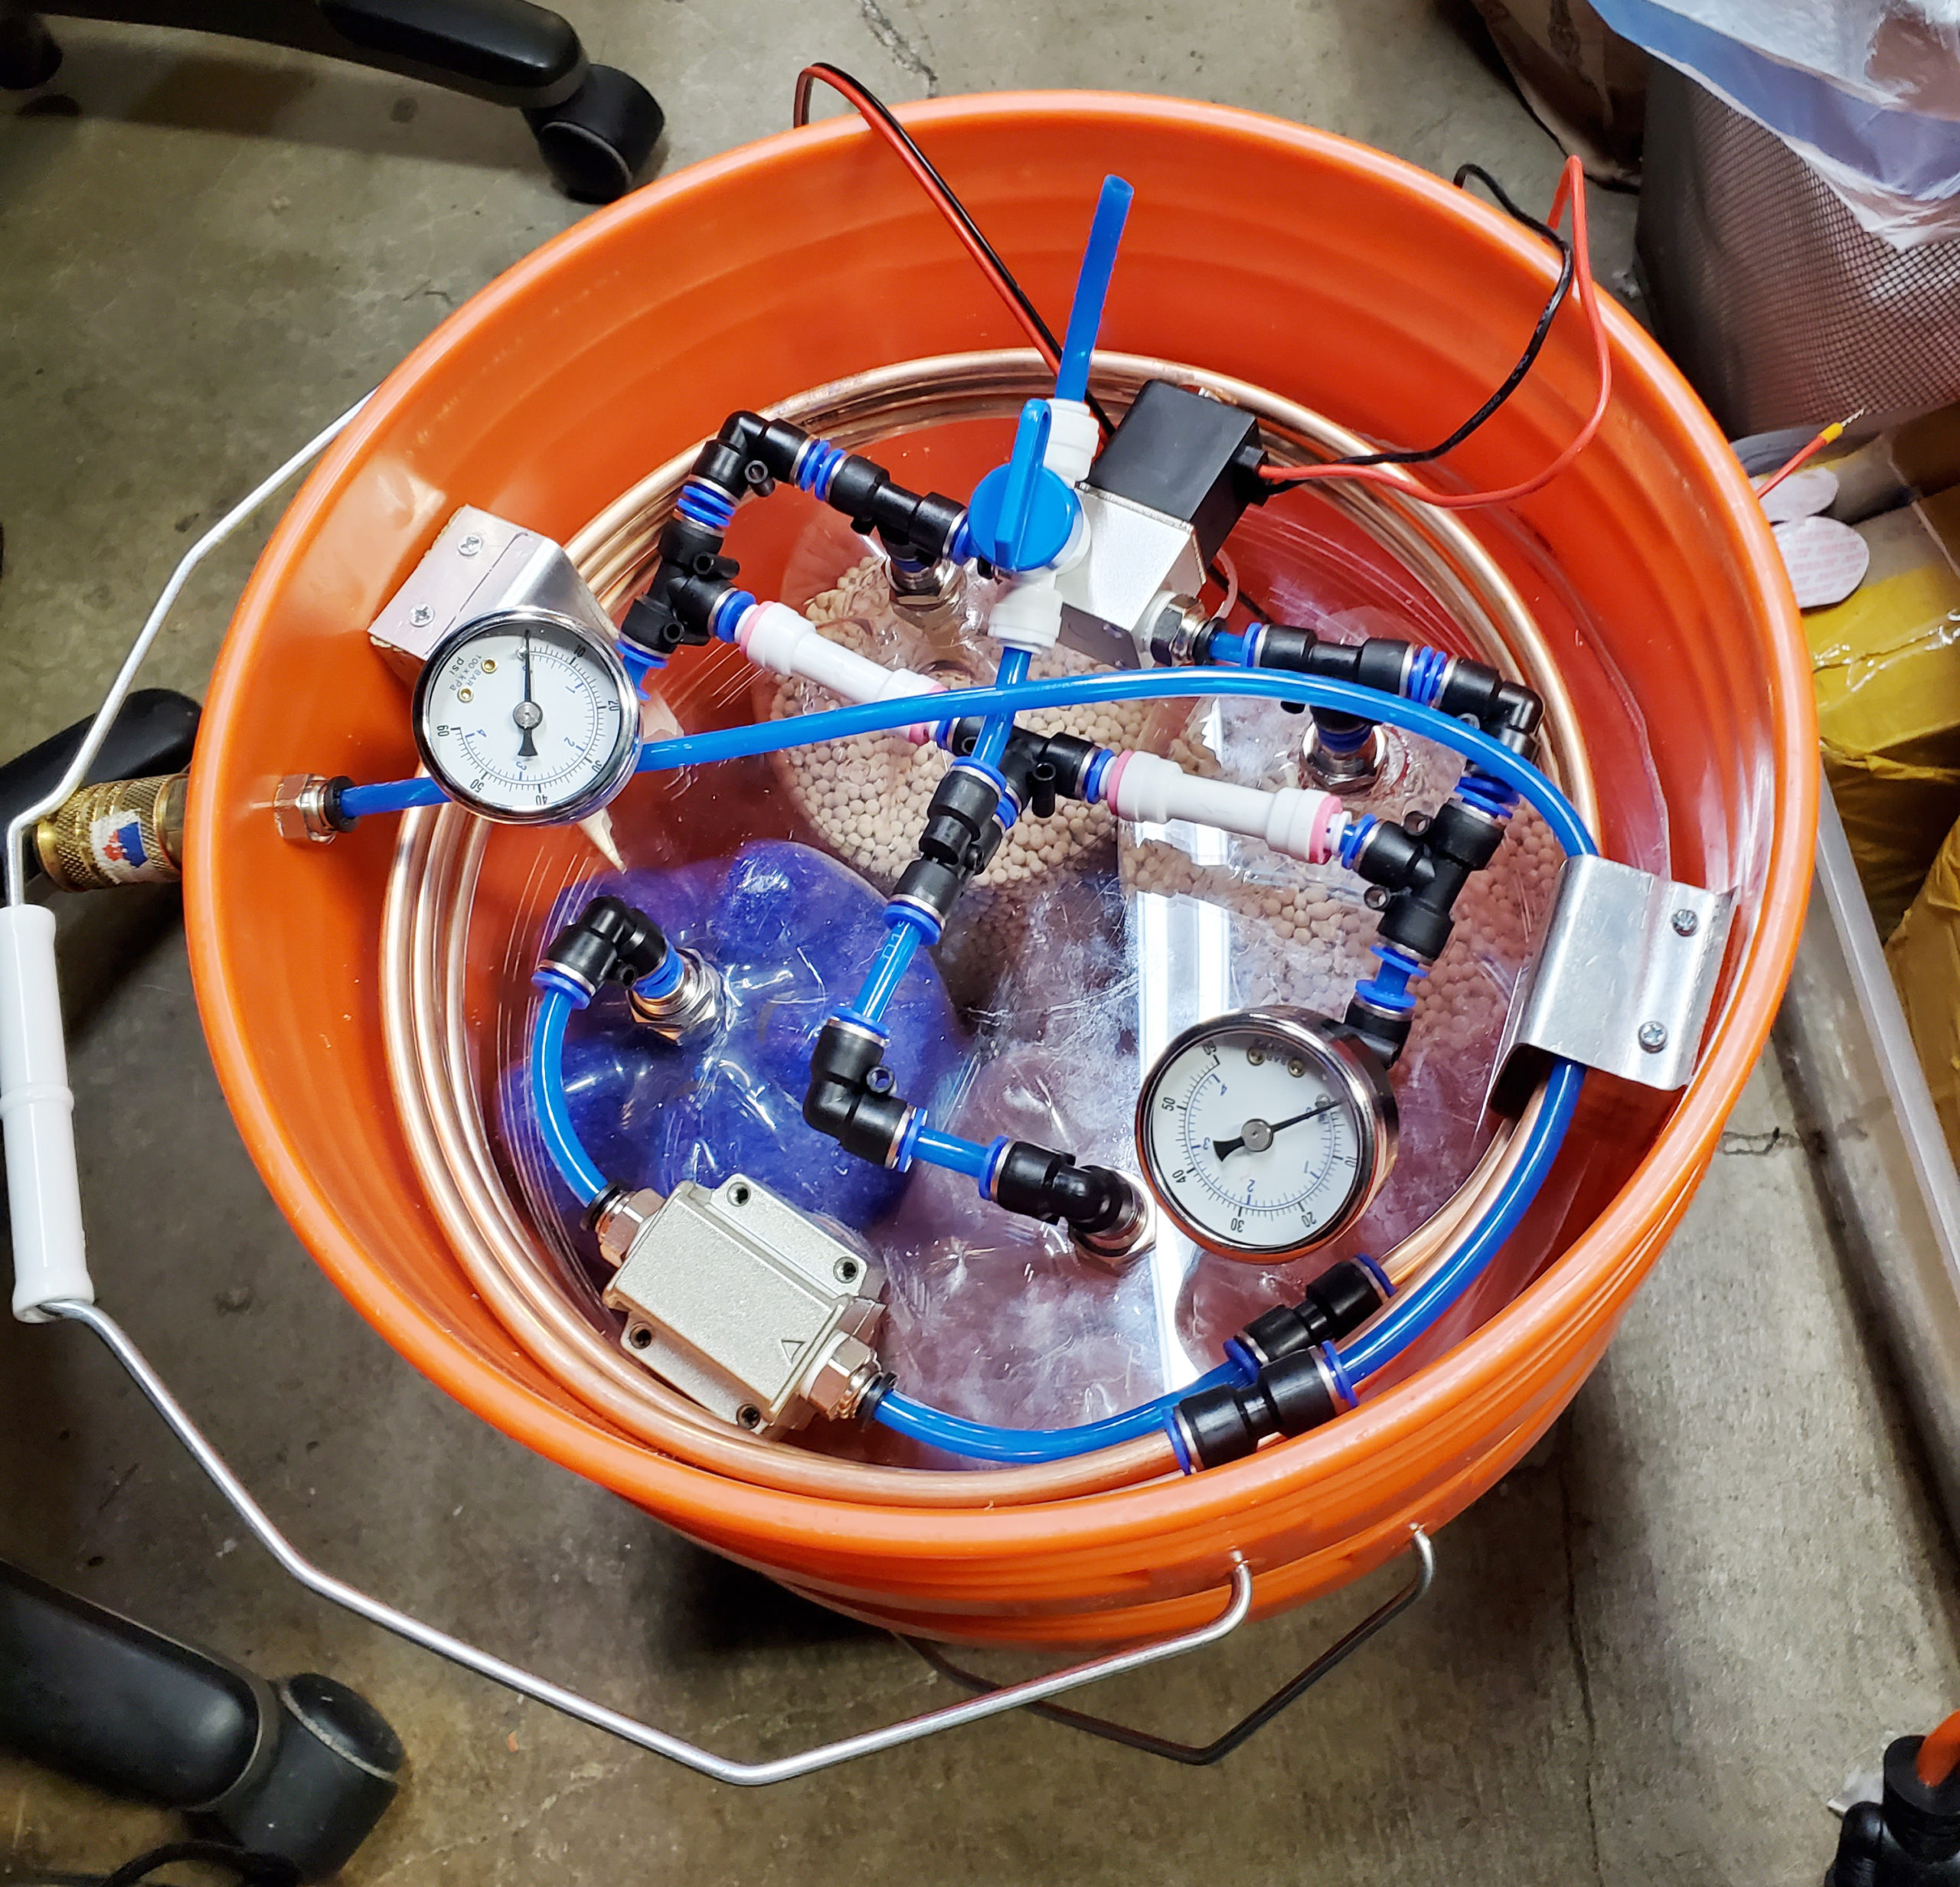
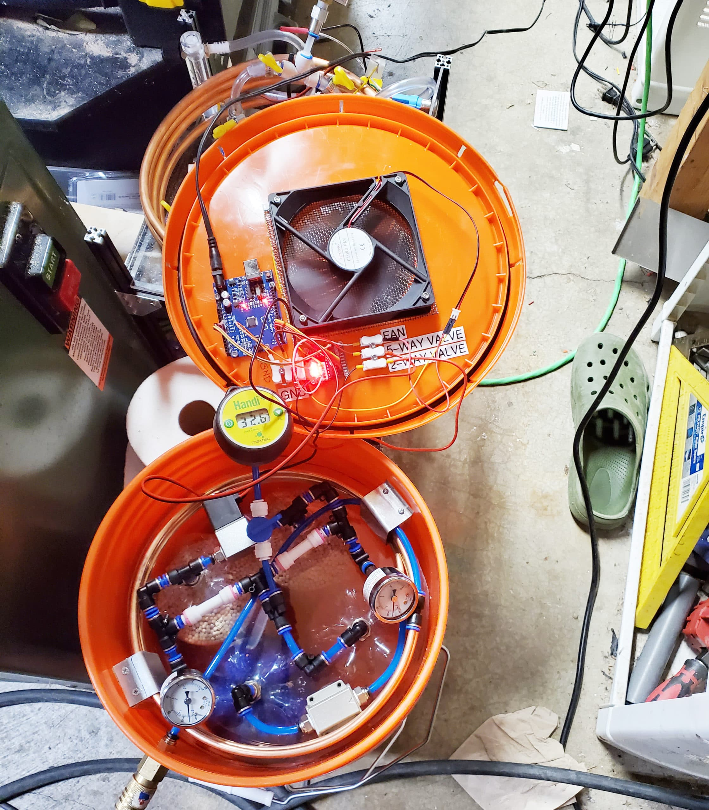
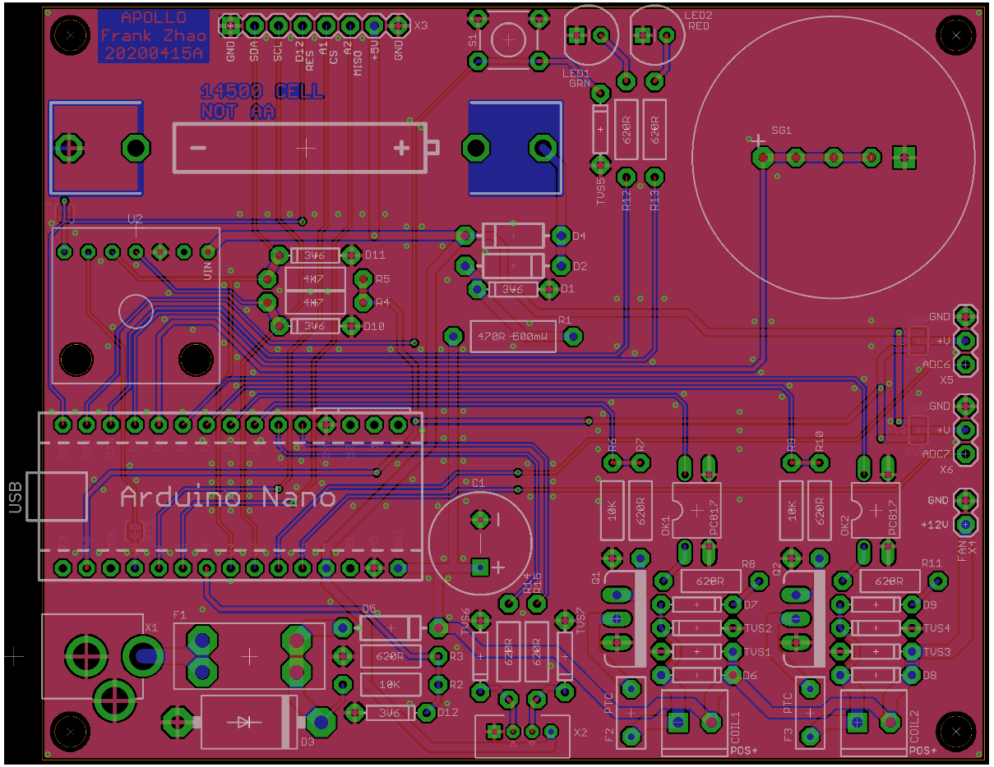
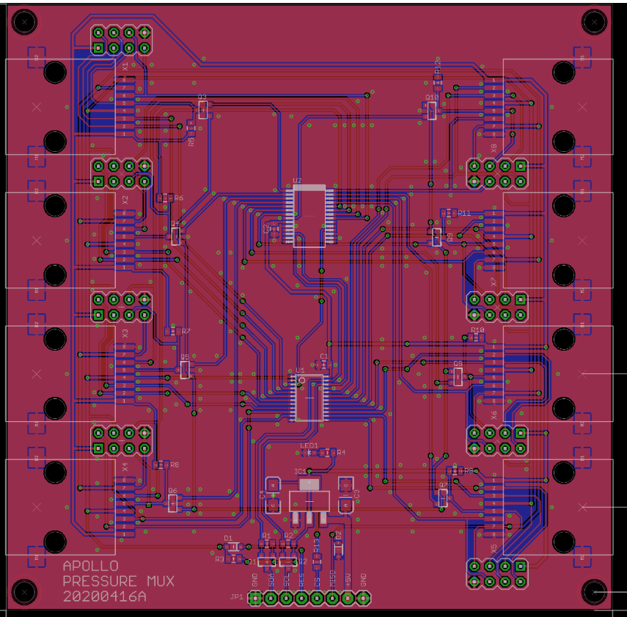
Project Apollo
Why
Ventilators need oxygen! (typical FiO2 0.3 … 1)
Oxygen generation is a big problem in developing countries.
No established infrastructure.
Oxygen bottles are expensive
People are already looking at alternative (local) ways for producing oxygen
What it is
Goal of the Apollo prototype = enabling people around the world to build the prototype ASAP
Focus = Simplicity and speed of build
Simple, reliable design (zeolite-based PSA system)
Flexible, open source, off-the-shelf materials
Very low cost (aspirational target = $100 for 5 liters/min @ 90%)
Final goal = Enable people to iterate and publish their own designs in the community
How to build it
Follow the published build documentation
Buy/source the materials (check out the BOM)
Build the prototype
Validate O2 concentration and flow. Use a good reference O2 and flow sensor for calibration
Think about risk analysis and assessment: template for Apollo-derived design
Document and iterate your own design. Publish your findings to the community!
Collaborations
Helpful Engineering, Public Invention, Oxikit, Microsoft Garage , Quick2space.org
Documentation
http://project-apollo.org

Slide 2
Project Apollo – latest progress
Next version (Apollo v4) coming soon
Focused on safety, user experience and maintainability
O2 compatible materials in the oxygen path
Dedicated PCB controller board, sensor integration, valve operational sensing
3” TFT touch screen for diagnostic messages, medical-grade buzzer
Auto-tuning (valve timing, auto-adjusts to changes in compressed air input pressure)
Integration with SpO2 oximeter Bluetooth sensors
Pulse mode prototype
Status
Mechanical design (collaboration with Public Invention)
Focus on FDA approval, sourcing deals @ volume and manufacturing
Please see project “Oxygen Concentrator” from Public Invention (@Ben Coombs)
Software prototypes for Apollo v4 – working
Simulation software
“device in the loop’ optimization strategies – tested and delivering close to theoretical
Can control Apollo for O2 generation and basic optimization
WiFi and Bluetooth integration TBD
Hardware design
Sensor selection - Sensors for pressure, humidity, temperature – selected and tested
Valve board – schematic in review, PCB in progress
Controller board – schematic in review, PCB in progress
Sensor board – schematic in progress, PCB in progress (inspired from Apollo v3)

Slide 3
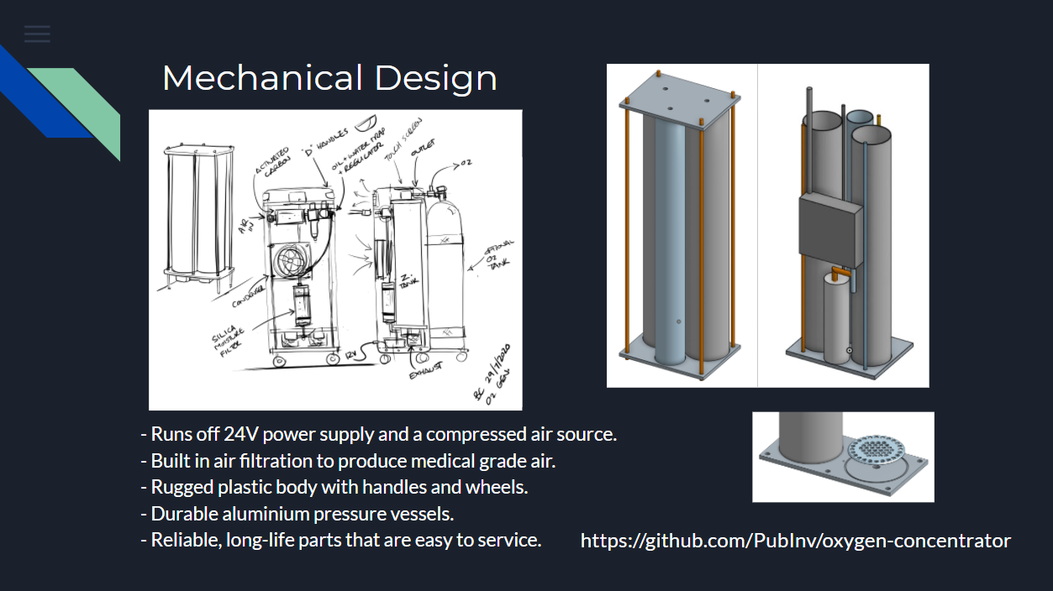

Slide 4
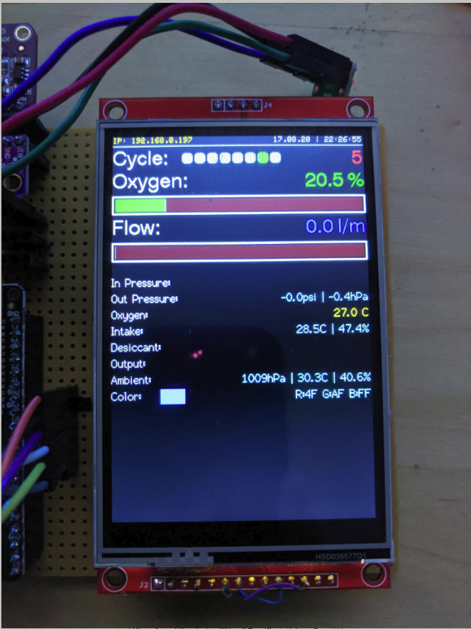
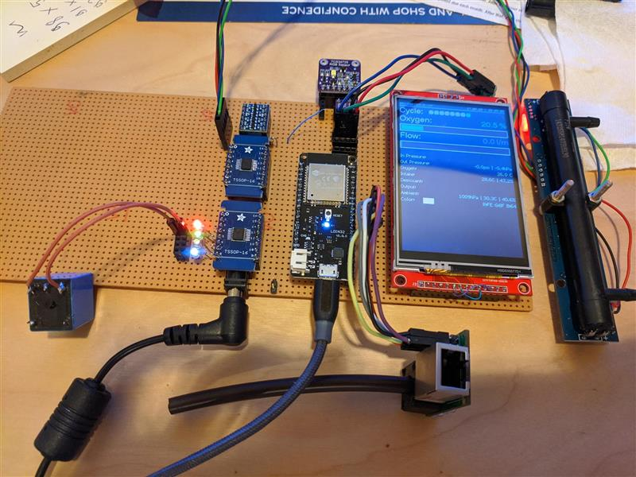
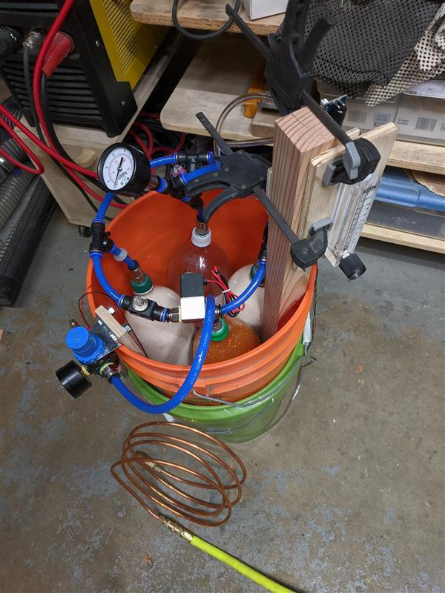
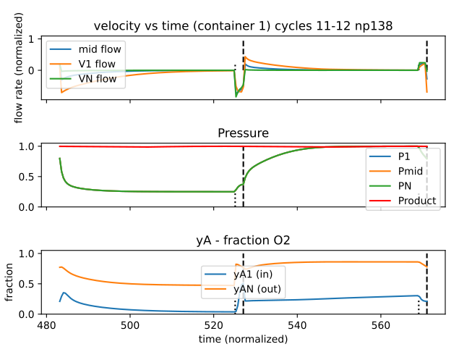
Prototyping effort – electronics, software

Slide 5
Conclusion
Apollo
Open source oxygen concentrator with focus on low-cost
When Apollo v4 comes out we encourage everyone to build one!
Please visit us at
http://project-Apollo.org
Track here our progress on Github for designs, PCBs and software
http://HelpfulEngineering.org
Slack channel = #project-oxygen-concentrator
www.pubinv.org
Public Invention main website

Slide 6
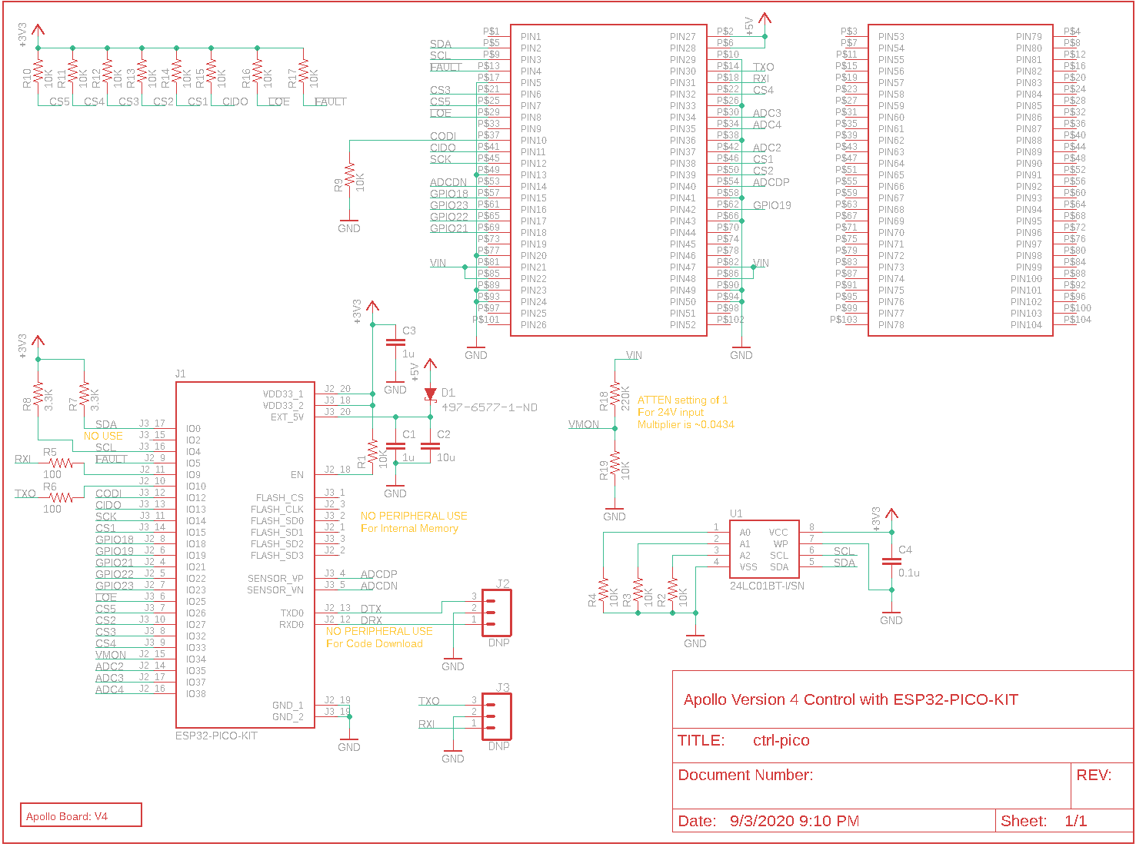

Slide 7
